Slide 1
V1 Leaseholders vs. NHG
FTT and UTT wins
Viridian Apartments, SW8 4DG

Slide 2
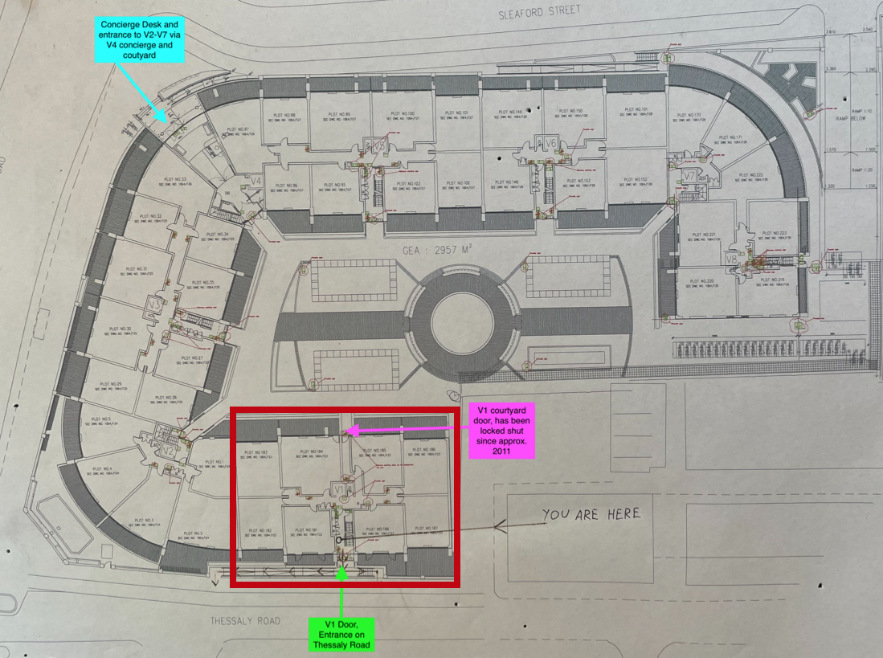
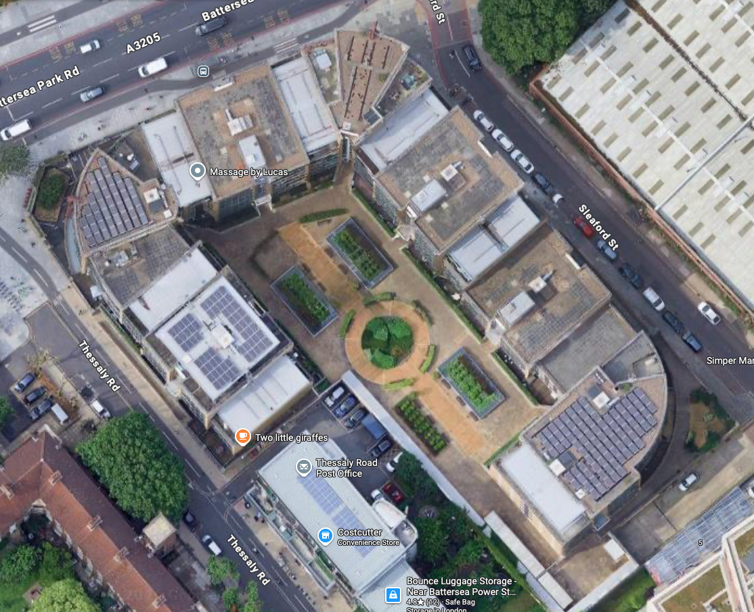
Context to the Service Charge Dispute
Shared Ownership Block

Slide 3
Issues
NHG’s Headlease includes liability for the Estate
Shared Ownership leases only make provision for the Block
Sales documentation from 2008 aligns with the shared ownership leases
Estate cost started to be passed on in 2014

Slide 4
Process
Get together – raise collective dispute (strength in numbers!)
Get legal advice and write formally to housing association
If unsuccessful, apply to first tier tribunal (property) FTT
Ensure proper legal representation at FTT despite the cost

Slide 5
Outcome
Win at FTT (July 2025) – which NHG appealed on 5 grounds
Win at UTT (June 2026) – all grounds for appeal dismissed
FTT: https://assets.publishing.service.gov.uk/media/686fade110d550c668de3dd5/Viridian_-_s.27A.pdf
UTT: https://caselaw.nationalarchives.gov.uk/ukut/lc/2026/235?tribunal=ukut%2Flc

Slide 6
Top Tips
Pay under protest - put this in writing early and keep a record
Coordinate action as a group and share the cost
Raise disputes early and pursue FTT if no action from
At FTT, provide witness statements (you have to be questioned)
Involve the press
Crowd funding

Slide 7
Press
My London/The Standard: https://www.mylondon.news/news/south-london-news/south-london-leaseholders-victorious-david-34283814
Property 118: https://www.property118.com/shared-owners-win-service-charge-appeal/
Local Government Lawyer https://www.localgovernmentlawyer.co.uk/property/404-property-news/101098-social-landlord-loses-appeal-over-charges-for-services-leaseholders-were-unable-to-access
Davies & Davies https://www.dda.law/legal-updates/pdf/viridian-apartments-v-notting-hill-genesis-housing-association-lon-00bj-lsc-2024-0256-when-the-lease-said-block-v1-not-please-fund-the-lifestyle-wing
Housing Today https://www.housingtoday.co.uk/nhg-loses-legal-bid-to-charge-shared-ownership-leaseholders-for-amenities-used-by-private-flat-owners-in-block/5143163.article
Inside Housing https://www.insidehousing.co.uk/news/significant-ruling-is-warning-for-sector-after-london-landlord-loses-appeal-to-pass-service-charges-for-private-flats-on-to-shared-owners-97875
HQN https://hqnetwork.co.uk/wp-content/uploads/2025/10/251009-Viridian-Apartments-SO-leaseholders-v-NHG-–-a-shared-owner-perspective-Sue-Phillips-and-Jennifer-Docherty.pdf
Shared Ownership Resources https://www.linkedin.com/posts/sue-phillips-fcca-2b551634_an-interesting-morning-at-the-royal-courts-activity-7459995668523212800-YGDR

